Slide 1
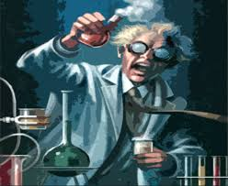

Welcome to Chemistry
Get ready to see your world in a new way….
How many atoms are the in a beaker of water?
How does your blood regulate its pH?
Why are some chemicals coloured when others are colourless?

Slide 2
What will the PowerPoint cover?
The AQA Chemistry Course
Practical Investigation-choose an experiment to do at home! ☹
Why Chemistry?
The Summer Task.

Slide 3
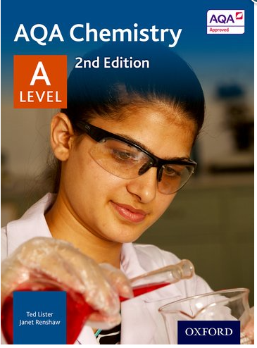
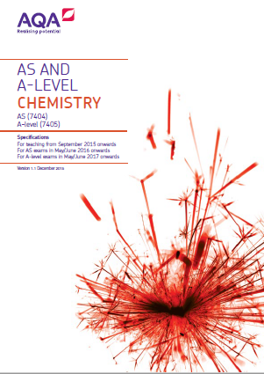
What you will study:
The specification has been developed in consultation with universities and UK teachers.

Slide 4
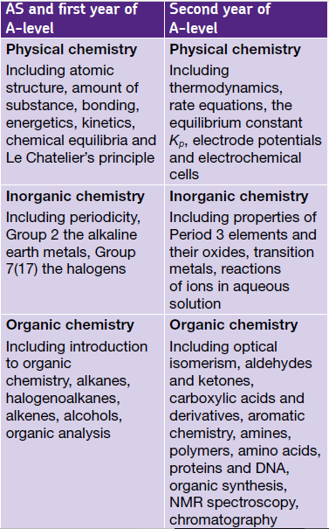
What you will study:

Slide 5
Assessment model –
Internal Year 12 exams (AFL & UCAS )
Paper 1
written exam: 1 hour 30 minutes
80 marks
50% of the year 12 exams
Paper 2
written exam: 1 hour 30 minutes
80 marks
50% of the year 12 exams
160 marks
3 hours total assessment time
A specified minimum weighting for maths at Level 2 of 20%
Synoptic assessment in both papers
Practical based questions included in both papers
Relevant Physical chemistry topics
Inorganic chemistry Relevant practical skills
Relevant Physical chemistry topics
Organic chemistry Relevant practical skills
65 marks of short and long answer questions
15 marks of multiple choice questions
65 marks of short and long answer questions
15 marks of multiple choice questions

Slide 6
Assessment model –
External Year 13 exams
Paper 3
written exam: 2 hours
90 marks
30% of A-level
Paper 1
written exam: 2 hours
105 marks
35% of A-level
Paper 2
written exam: 2 hours
105 marks
35% of A-level
Synoptic
Any content
Any practical skills
Relevant Physical chemistry topics
Inorganic chemistry Relevant practical skills
Relevant Physical chemistry topics
Organic chemistry Relevant practical skills
40 marks of questions on practical techniques and data analysis
20 marks of questions testing across the specification
30 marks of multiple choice questions
105 marks of short and long
answer questions
105 marks of short and long
answer questions

Slide 7
Practical skills-Year 12
Make up a volumetric solution and carry out a simple acid–base titration.
2 Measurement of an enthalpy change.
3 Investigation of how the rate of a reaction changes with temperature.
4 Carry out simple test-tube reactions to identify:
cations – Group 2, NH₄⁺
anions – Group 7 (halide ions), OH–, CO₃^{2–} , SO₄^{2–}
5 Distillation of a product from a reaction.
6 Tests for alcohol, aldehyde, alkene and carboxylic acid.
Notes:
Scaffolded means activities provided by OCR will provide instructions to be followed. But, if you want, you can set less scaffolded activities for these groups.

Slide 8
Practical skills
7 Measuring the rate of reaction:
by an initial rate method
by a continuous monitoring method
8 Measuring the EMF of an electrochemical cell.
9 Investigate how pH changes when a weak acid reacts with a strong base and when a strong acid reacts with a weak base.
10 Preparation of:
a pure organic solid and test of its purity
a pure organic liquid
11 Carry out simple test-tube reactions to identify transition metal ions in aqueous solution
12 Separation of species by thin-layer chromatography
Notes:
Scaffolded means activities provided by OCR will provide instructions to be followed. But, if you want, you can set less scaffolded activities for these groups.

Slide 9
Practical Investigation –
https://edu.rsc.org/resources/collections/global-experiments
Follow this link. There are several experiments that were run by the Royal Scociety of Chemistry on a global scale. They have now all closed so you cannot upload data- but there is nothing to stop you choosing one of the experiments and sharing the results with me. You can even send in pictures & I will then share them with the rest of our class!
This is optional but….it could be fun….give it a go! ☺

Slide 10
Why Chemistry
http://www.rsc.org/careers/future/
It’s worth exploring the Royal Society of Chemistry Website over the summer (http://www.rsc.org).
Now is an opportunity to explore the scientific community you are joining on social network, the internet is full of Science and Chemistry blogs, twitter accounts and podcasts. A quick search for some key terms that interest you can reveal some true gems, for those unsure where to start www.compoundchem.com is a fascinating blog and “The Infinity Monkey Cage” is a great podcast.

Slide 11
Summer Home learning
Thee accompanying letter is more detailed but…
Read and complete the questions on the scanned sheets.
Read through the AQA Transition Pack booklet you have been given and complete the activities.
Then complete the ‘Key Facts to Find and Learn’ worksheet.
If you read the letter you will find out where to find answers!
You will be tested on the ‘Key Facts to Find and Learn’ during your first Chemistry lesson in September.
The test may also include some of the facts from the
AQA Transition Pack
And yes the test is important- otherwise we wouldn’t ask you to do it!☺

