Slide 1
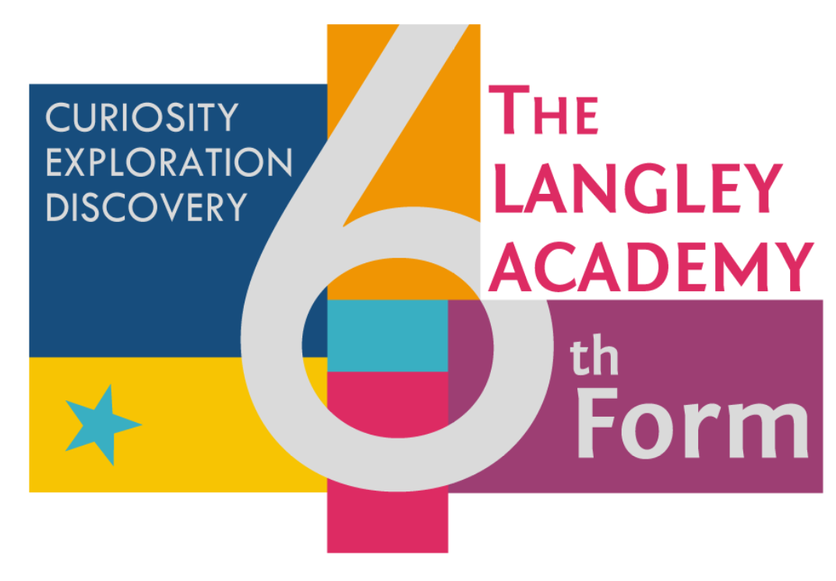
Open Evening 2018
Langley Academy Sixth Form

Slide 2
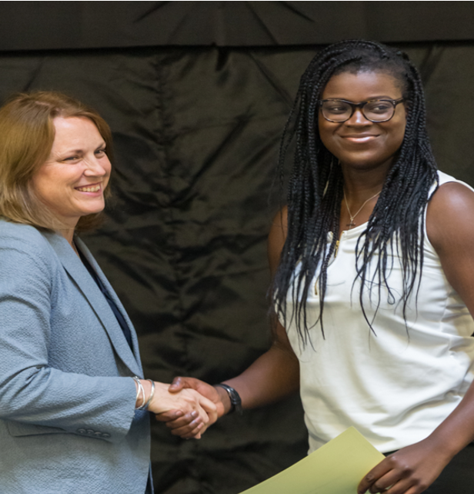
Headteacher - Alison Lusuardi

Slide 3
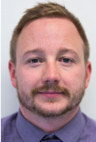
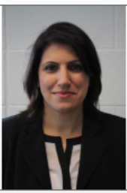
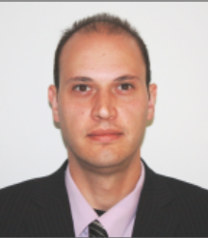
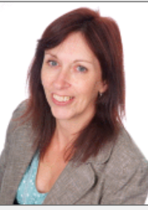
Roles and Staff
Mr Forth - Assistant Headteacher
Ms Chana - Sixth Form Administrator
Mr Chinchen - Head of Year 13
Ms Clark - Sixth Form Attendance

Slide 4
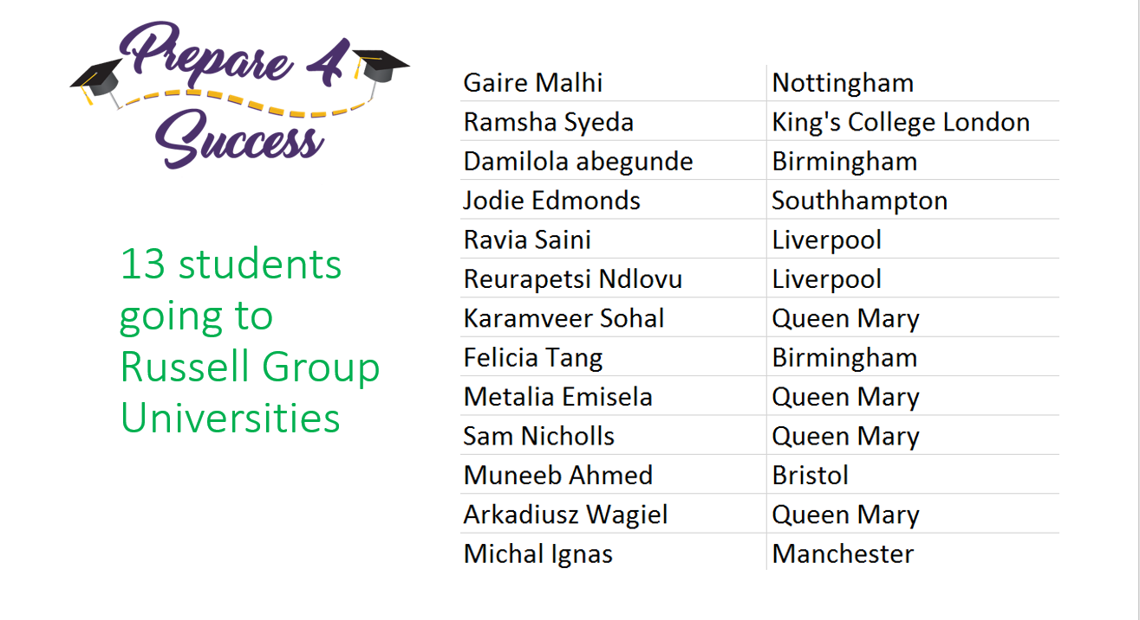

Slide 5
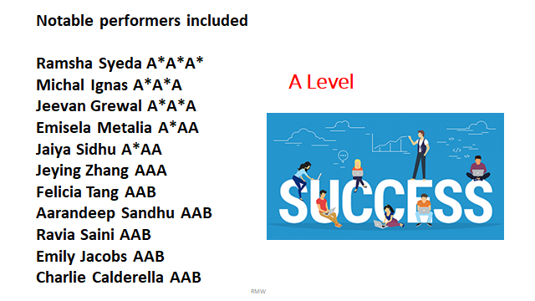

Slide 6
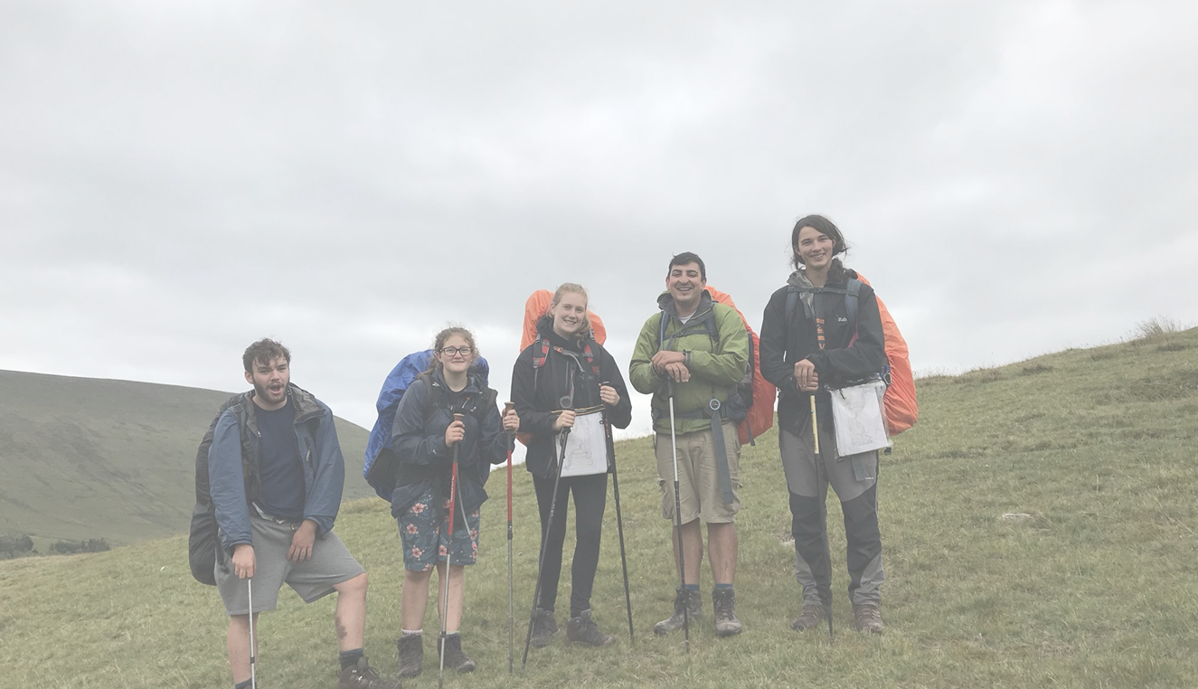
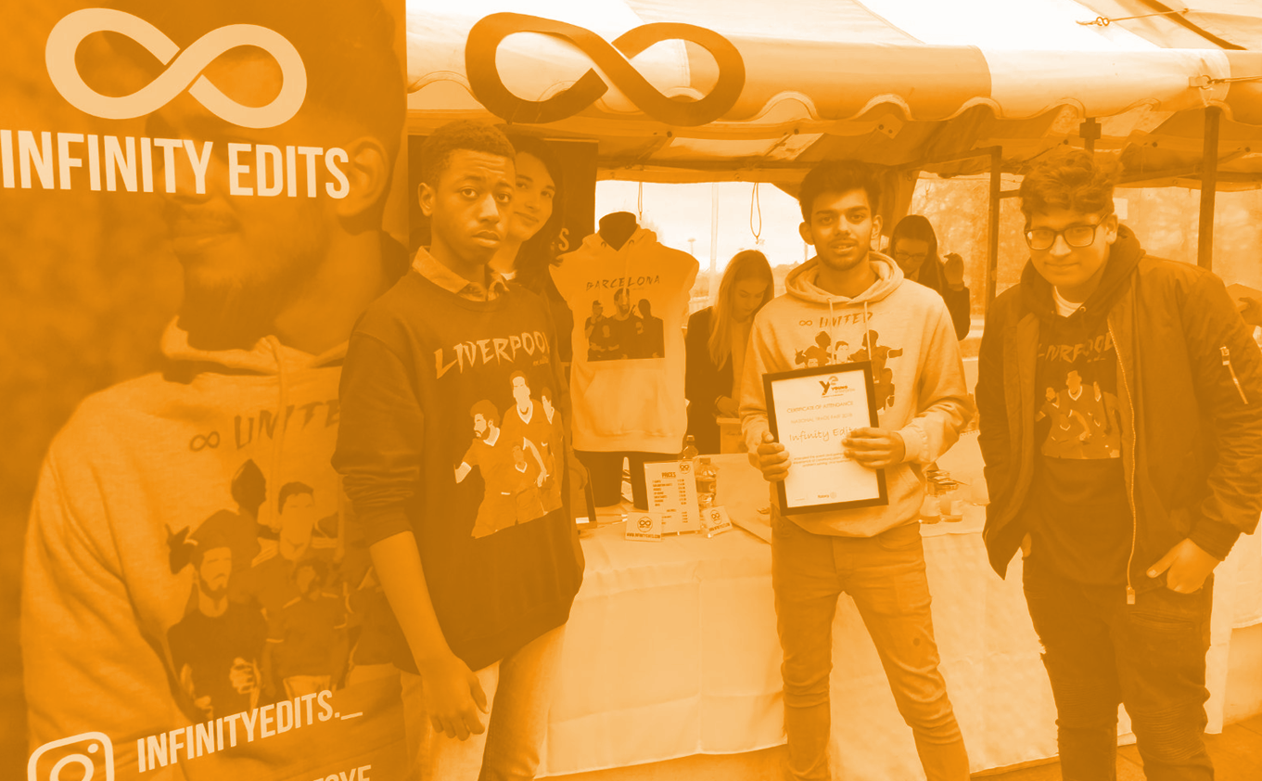
Enrichment
Community Service (80 hours)
  Range of ways to give back to the school and local community
    Lower school mentoring
    Primary school volunteering
    Assisting local charities and organisations
Young Enterprise
  Company Programme
Duke of Edinburgh
  Gold Award
Work Experience
  Full week in Year 12
  Range of experience opportunities throughout the sixth fo form

Slide 7

UCAS
Full support programme starting in Year 12 including:
Personal Statement Workshops
External Support Sessions on Personal Statements
University Speakers
University Open Days
Oxbridge Support
  Mock Interviews at Eton
  Meetings with Oxford Admissions Tutor
Specialist support from dedicated staff for other post 18 opportunities including Apprenticeships, employment and further training

Slide 8

Pastoral Care
Pastoral Tutors
Student Support Service
Counselling Service
External sessions on topics such as:
  Exam Stress
  Mindfulness
  Personal Issues
  Personal Finance and Banking
  Life Skills
  Careers and Next Steps

Slide 9
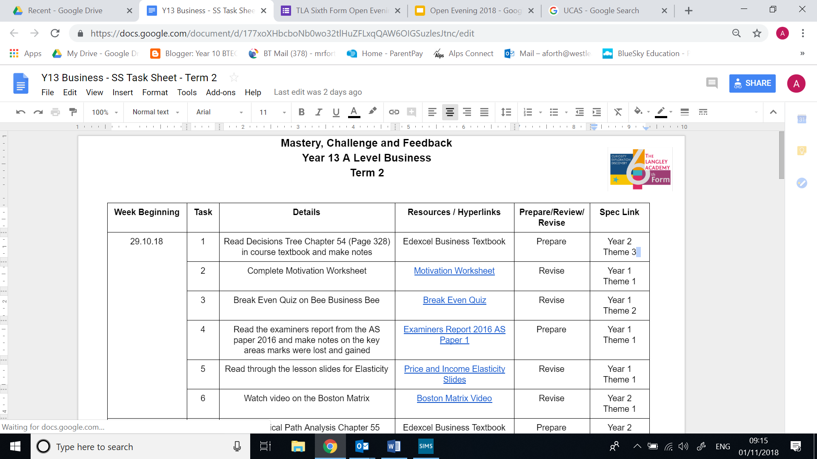
Supervised Study
Dedicated Supervised Study Room
Five hours per week
Supervised study teachers for every session offering support and guidance
Quiet working space for students to complete further reading and extend knowledge base
Task sheets created by subject areas to give students structured specific work to complete

Slide 10
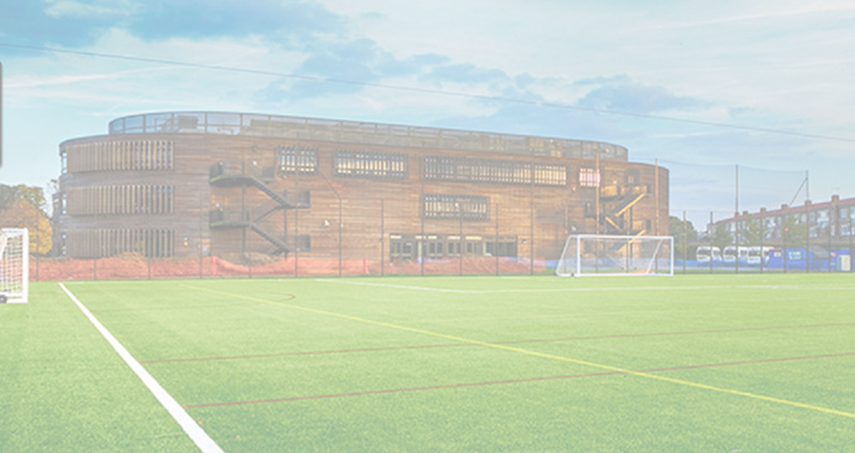
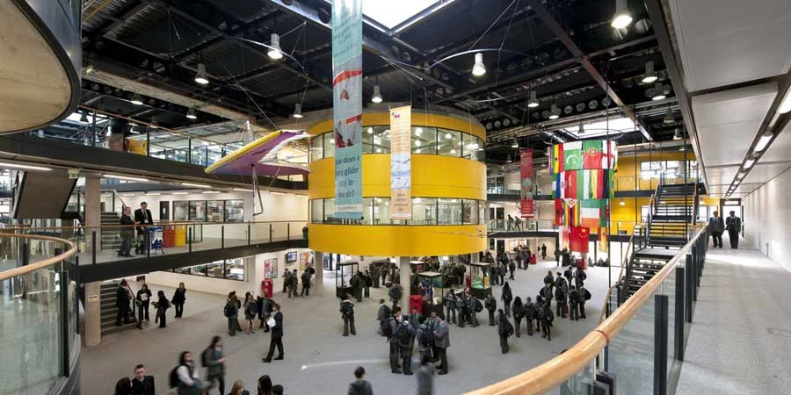
Facilities
State of the art school buildings with outstanding facilities and ICT access
New bespoke Sixth Form building to be opened January 2020
Full refurbishment of current Sixth Form area from September 2019 to include excellent classroom facilities and sixth form cafe

Slide 11

TLA Expectations
At TLA sixth form we expect our students to:
  Attend every lesson prepared to learn
  Wear the correct uniform and be proud of it
  Support each other
  Challenge themselves in everything they do
  Give their very best every day
  Not give excuses

Slide 12
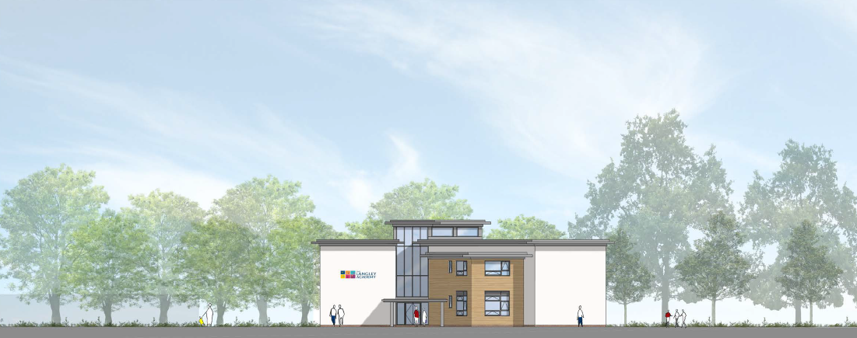
New Building - Front

Slide 13
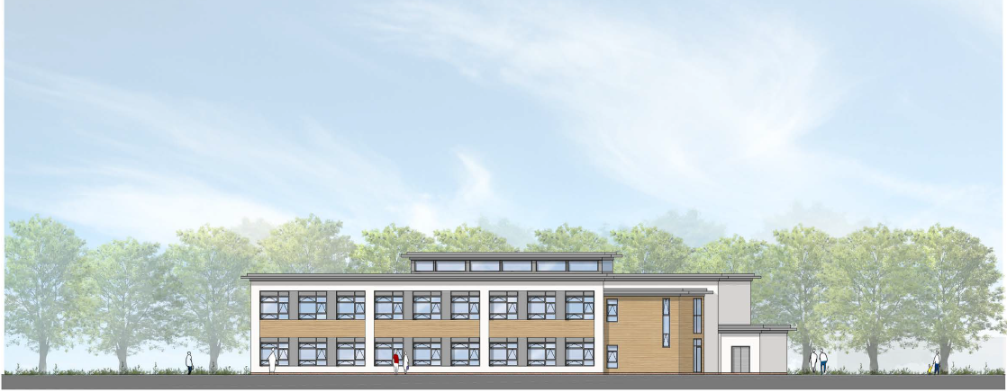
New Building - Side Aspect

Slide 14

Student Talks
Year 13 Leadership Team
Junead Khan - Head Boy
Haaniya Adnan - Head Girl
Current Year 12
Luca Gabella - Internal
Physics, Chemistry, Maths
Aaryaman Walia - External
Politics, Economics, Maths
Previous Students
Ramsha Syeda / Danielle Deadman

Slide 15
SIXTH FORM OPEN EVENING
Ramsha Syeda

Slide 16

A LITTLE ABOUT ME…
Studying Dentistry at King’s College London
Biology, Chemistry, Maths and Further Maths AS
GCSEs: 12A*s, 1 A
A-levels: A*A*A* A

Slide 17
6th form- my experience
4 subjects:
  French, Biology, Psychology, PE
Sports team
Summer school
Notes:
AS in French. A level in other 3. Jump between GCSE and A level. Can sometimes be draining when finding a particular subject/topic difficult.
Netball team. Ways to de-stress. Not as many available as more study focused, but still there.
Surrey university. Experience uni life. Other opportunities-work experience. Uni trips

Slide 18
Life post 6th form
Not what I had planned
Full time employment
Now planning on degree level apprenticeship in physiotherapy
Still receiving great training and support on the job
Notes:
Where I am now is completely different to where I thought I’d be when I was sitting here.
Planned to go to uni, nursing degree, for a long time. Closer to time, changed mind. Researched physio PS for that, psychology-PS for that. Applied for uni-secured all places. Reserached other options found job, declined offers.
Physiotherapy assistant@WPH
Constant learning+training opportunities
Current plan-apprenticeship next year in physio

Slide 19
How to get the best out of 6th form
Have a plan (ish)
Use your time effectively
Find the right balance for you
Be organised
ENJOY IT
Notes:
Plans can change, they don’t need to be set in stone. Good for some sort of plan for subject choosing. Do research, use careers advisor
Use free periods. A lot of independent learning. Be realistic.
Have a social life. Part time work. Fit in study.
Revision timetables. Have to do lists/due dates for coursework asap. Have folders with notes+revision sources. Pritoritise.
Last 2 years of school. Work your hardest, make most of the opportunities given.

Slide 20

Why TLA? A Summary
It is what most of you are used to
Outstanding Pastoral Care
Excellent Academic Results
Positive Student Destinations
Outstanding Facilities
Wide Enrichment Opportunities

Slide 21
Layout of the Evening
CAPA - ROOM N006
(Art, Drama, Media, Music, Photography)
SCIENCES - ROOM P101
(Biology, Chemistry, Physics, Psychology, Science)
MATHEMATICS - ROOM N102
(Mathematics, Further Mathematics)
HUMANITIES AND ENGLISH - ROOM N104
(English, Geography, History, Philosophy, Politics, Sociology)

Slide 22
Layout of the Evening
BUSINESS AND ECONOMICS - ROOM N105
(Business, Economics)
PRODUCT DESIGN AND VOCATIONAL - ROOM N108
(Product Design, Health & Social Care, Travel & Tourism)
MODERN FOREIGN LANGUAGES AND ICT - ROOM N109
(Languages, Computing, ICT)
SPORT - ROOM N112
(Physical Education, Sport)

Slide 23

Tips for the evening
Ask lots of questions to staff and students
Collect prospectus and subject information sheets
Visit every faculty
Complete student survey
After the evening
Review subject sheets and further information in prospectus
Consider subject entry requirements and current GCSE predictions
Apply using the application form in the prospectus / online

